Slide 1

Chicago Crime Analysis
Project Group H -
Nandish Patel (45539510),
Tarun Kumar (45534632)
Sai Kiran Ravula(45539146)
Ali Saeed (45853762)

Slide 2
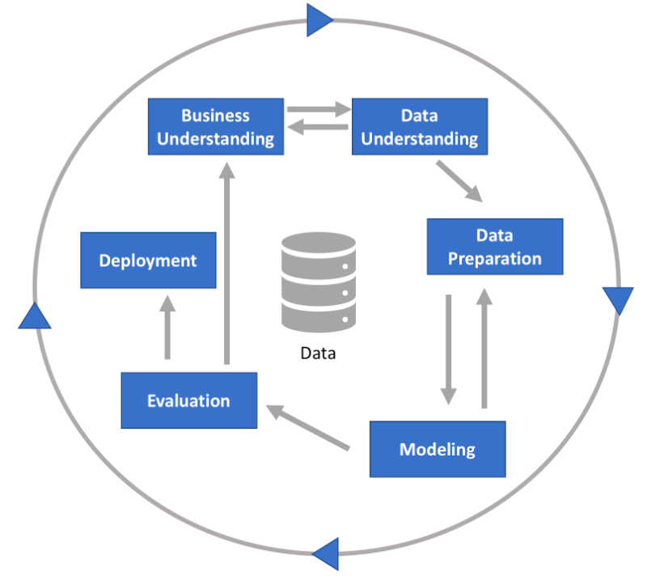
Project Vision
Analyzing Chicago Crime Data by implementing CRISP-DM Approach:
CRISP-DM stands for Cross-industry Process for Data Mining.
This methodology provides a structured approach
to plan a data mining project.
It is a robust and well-proven methodology.

Slide 3

Background
The glorious city of Chicago has been pestered with unlawful and violent acts over the years.
The scale of these heinous acts is such that its crime rate is substantially higher than that of the country’s average.

Slide 4
Business Understanding & Objective
Our business problem would be to find the underlying relations in data which might reveal some interesting insights regarding crime patterns and help us forecast some noteworthy results.
Intended Users of this business model: Chicago Police Department
To identify the most frequent modes of crime.
To understand the role of Geography on a potential crime.
Building scalable models to precisely predict the frequency of impending crimes.

Slide 5
Data Understanding
This dataset echoes reported incidents of horrendous crimes that transpired in the City of Chicago right from 2010 to the current year, 2019. The data has been extracted from the Chicago Police Department's CLEAR (Citizen Law Enforcement Analysis and Reporting) system. It also includes unverified reports and anonymous tips supplied to the Police Department but among a minority.
The original dataset (from the year 2001) is in a CSV format comprising 6.96 million observations and 30 features where each row represents a reported crime. A subset (2010-2019) of this huge collection is being considered for further analysis. This subset has around 2.88 million observations with the same number of features.
Overview of all the variables in the dataset are shown further.

Slide 6
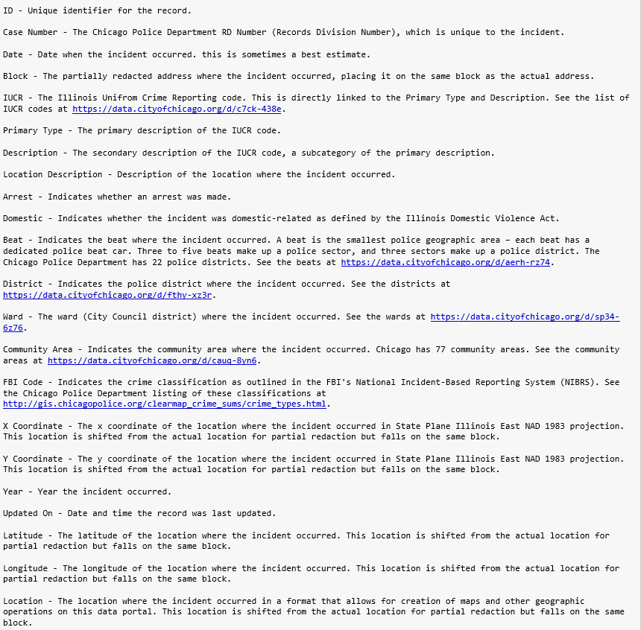

Slide 7
Data Preparation
As a part of tidying the data, among 30 columns, a few columns like ID, Case Number, Updated on, Historical Wards 2003-2015, IUCR, Description and Beat have been excluded from the model building process as they just add dead-weight to the procedure. Also, the column ‘Date’ has been split into Year, Month, Week, Day and Hour for intricate analysis.
A few records were missing in the following features: Location Description, District, Ward, Community Area, Latitude and Longitude and Zip Code. They have been dropped as they were a miniscule when compared to the record count in the respective feature.
As for pre-processing the data, features such as Community Area, Beat and Ward have been converted to categorical variables, to retain their true properties. Also, integer features have been converted to nominal variables for better analysis. For instance, District codes can be replaced with the name of the district.

Slide 8
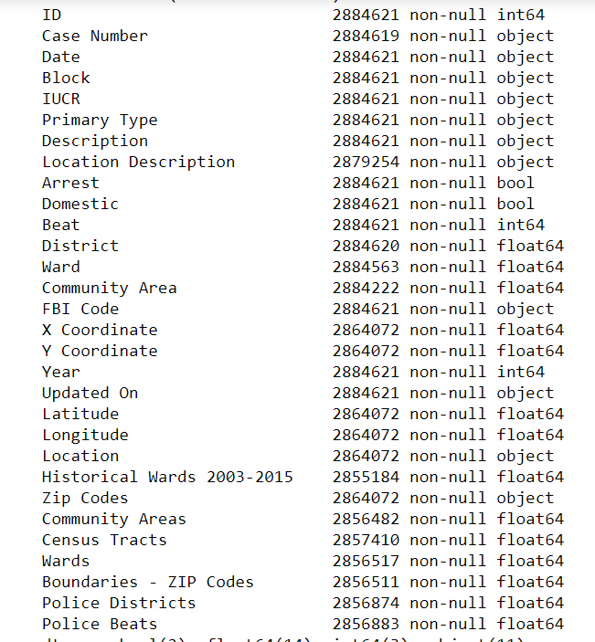
Missing Data
Here we can see that there are missing values in the data. The count of non null values are shown here with column type.

Slide 9
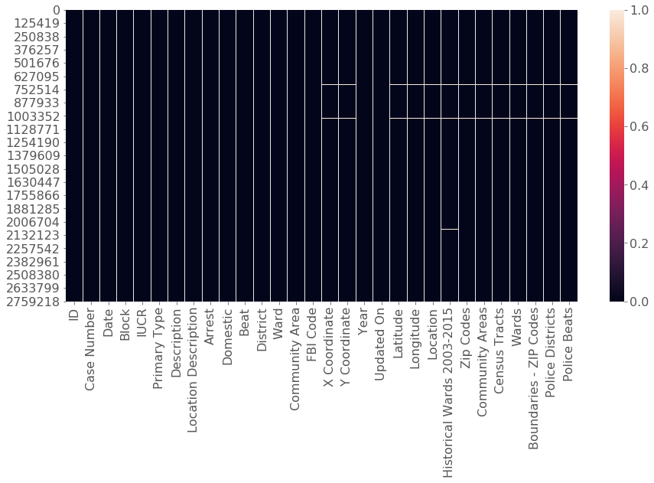
Plotting Missing Data before Pre-processing

Slide 10
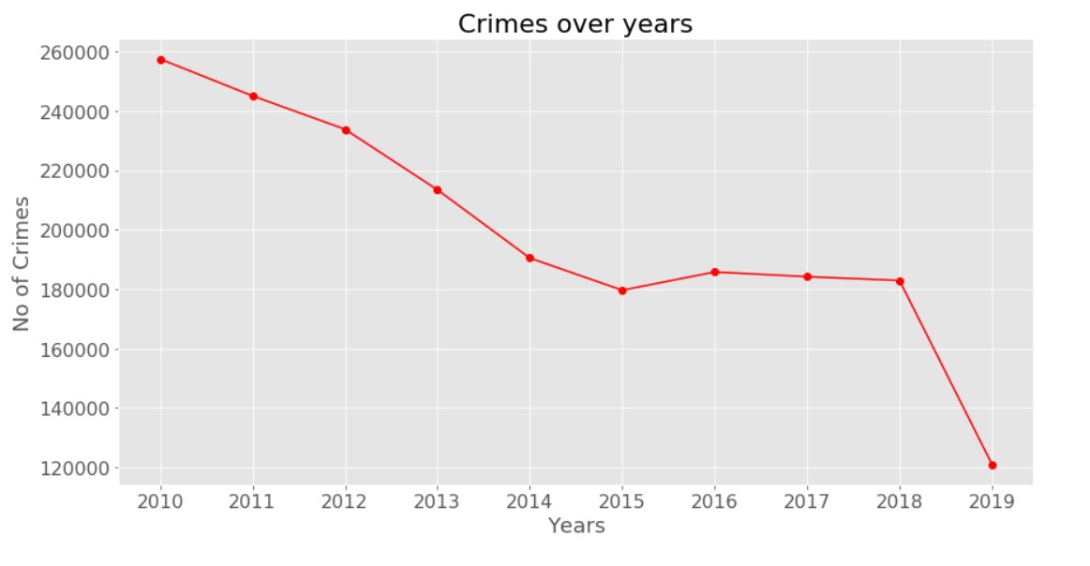
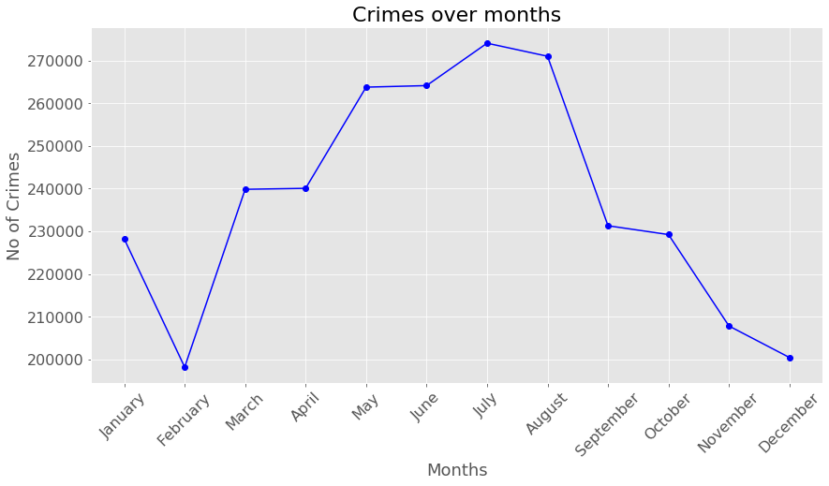
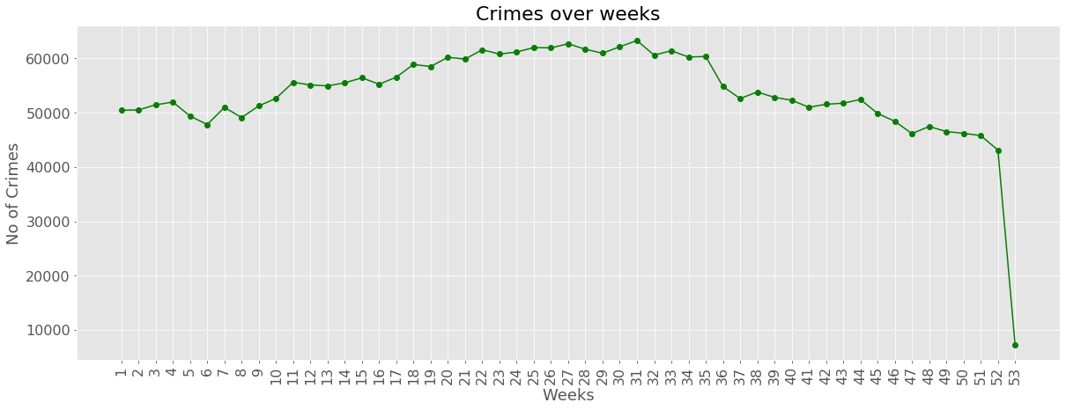
Visualization of key variables in data

Slide 11
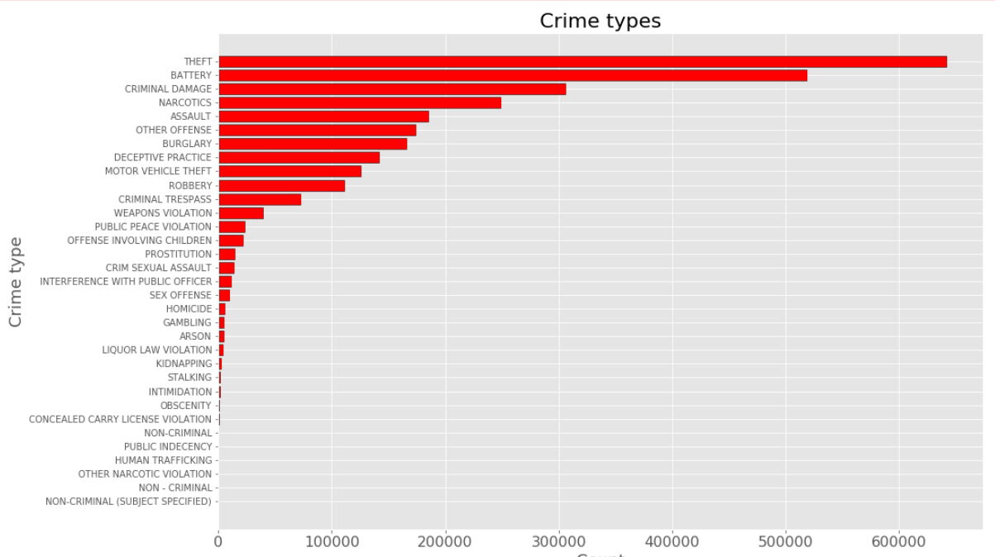
Visualization of key variables in data

Slide 12
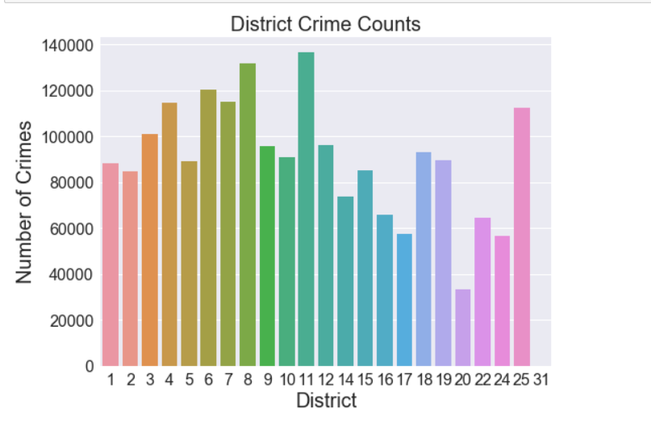
Visualization of key variables in data

Slide 13
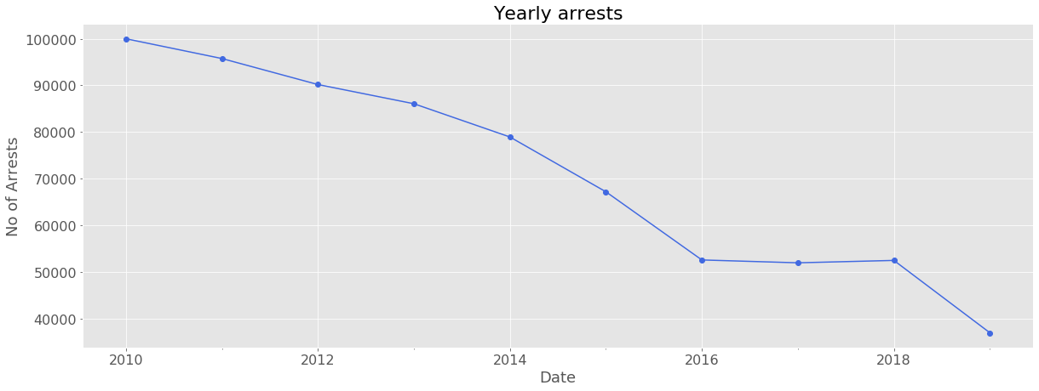
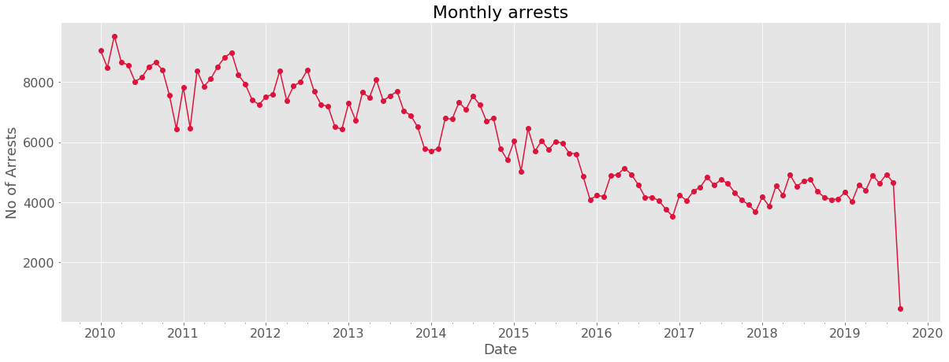
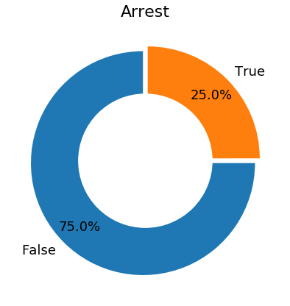
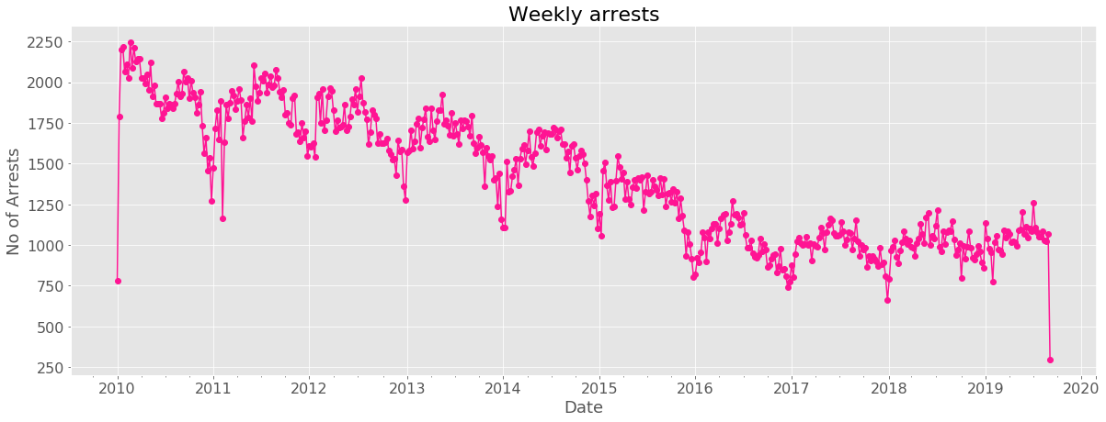
Visualization of key variables in data

Slide 14
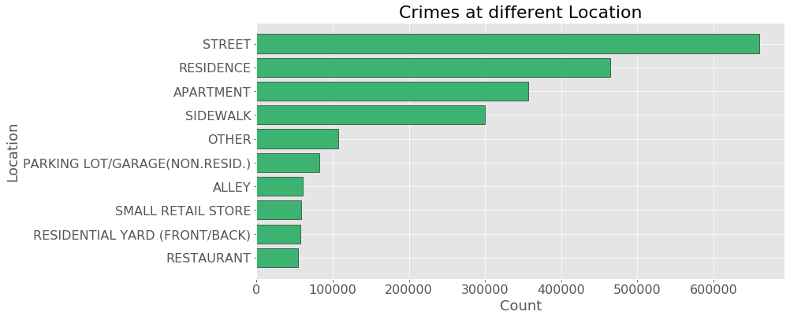
Visualization of key variables in data

Slide 15
Binary Classification Modelling
Target Variable – Has the criminal been arrested? -> 0 or 1
Models – Logistic Regression, Random Forest, Naïve Baye’s, Neural Network.
Data Pre-processing: The column ‘Date’ has been split into four individual columns; Year, Month, Week and Day for better analysis. These features were further converted into nominal codes.
Fitting various combinations of the models by tuning the parameters yielded the following results:

Slide 16
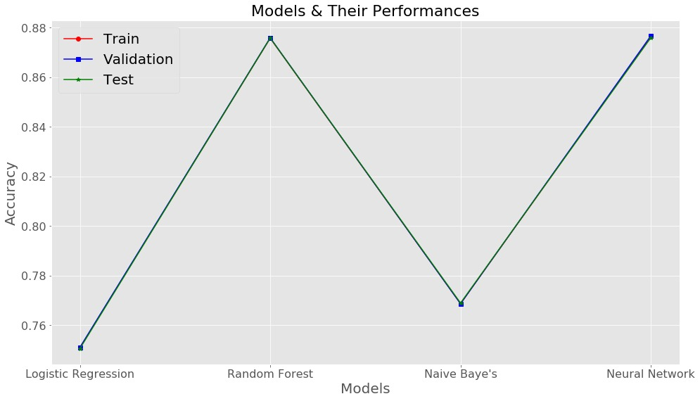
Results
Visualized Accuracies
ACCURACIES
Model | Train | Validation | Test
Logistic Regression | 75.07 | 75.09 | 75.04
Random Forest | 87.57 | 87.59 | 57.58
Naïve Baye's | 76.86 | 76.85 | 76.88
Neural Networks | 87.63 | 87.67 | 87.59

Slide 17
Multiclass Classification Modelling
Target Variable – In which District was the crime committed? -> 23 labels
Models – Logistic Regression, Random Forest, Naïve Baye’s, Neural Network.
Data Pre-processing: The column ‘Date’ has been split into four individual columns; Year, Month, Week and Day for better analysis. These features were further converted into nominal codes.
Fitting various combinations of the models by tuning the parameters yielded the following results:

Slide 18
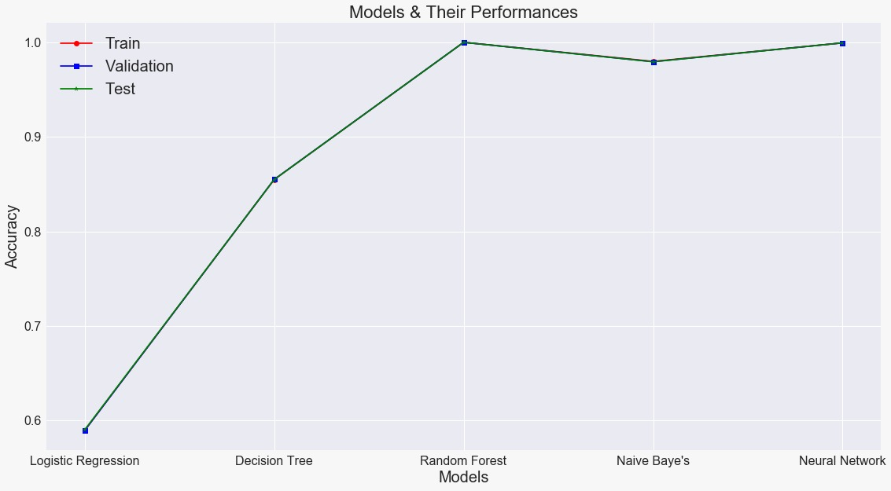
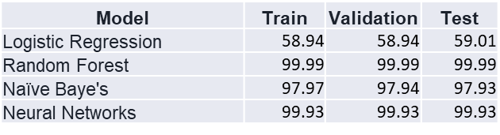
Results
Visualized Accuracies
ACCURACIES

Slide 19
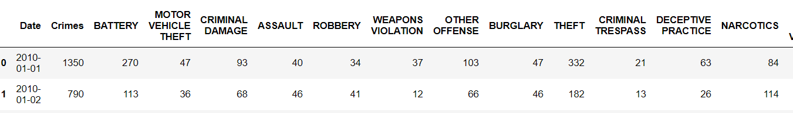
Time series Analysis
Target variable = Predicting total number of crimes in a day.
Models = ARIMA and SARIMA(On the next slide)
Data Pre-processing
To create training data for the model, We grouped the dataframe by day and calculated total number of crimes.
We have also converted various crime type to the columns. For example “ASSAULT” will be a new column in the training data containing total number of crimes(“ASSAULT”) happened on a day.
To avoid poor performance of the model due to some rarely occurring crimes, We have removed the following crime types from the data. Deleted columns are 'INTERFERENCE WITH PUBLIC OFFICER', 'LIQUOR LAW VIOLATION', 'PROSTITUTION', 'CRIM SEXUAL ASSAULT’, 'INTIMIDATION','SEX OFFENSE', 'CONCEALED CARRY LICENSE VIOLATION', 'HOMICIDE', 'KIDNAPPING', 'ARSON’, 'GAMBLING', 'OFFENSE INVOLVING CHILDREN', 'STALKING', 'OBSCENITY', 'HUMAN TRAFFICKING', 'PUBLIC INDECENCY’, 'OTHER NARCOTIC VIOLATION', 'NON-CRIMINAL', 'NON - CRIMINAL', 'NON-CRIMINAL (SUBJECT SPECIFIED)’.
Data looks like this.

Slide 20
ARIMA and SARIMA
ARIMA = AUTOREGRESSIVE INTEGRATED MOVING AVERAGE
SARIMA = SEASONAL AUTOREGRESSIVE INTEGRATED MOVING AVERAGE
The AR part of ARIMA indicates that the evolving variable of interest is regressed on its own lagged (i.e., prior) values. The MA part indicates that the regression error is actually a linear combination of error terms whose values occurred contemporaneously and at various times in the past. The I (for "integrated") indicates that the data values have been replaced with the difference between their values and the previous values. ARIMA(p, d, q) → p AR terms, q MA terms and dth order difference.
Although ARIMA can handle data with a trend, it does not support time series with a seasonal component.
An extension to ARIMA that supports the direct modeling of the seasonal component of the series is called SARIMA. ARIMA(p, d, q)(P, D, Q) where P Seasonal AR terms, Q Seasonal MA terms and Dth order Seasonal difference.

Slide 21
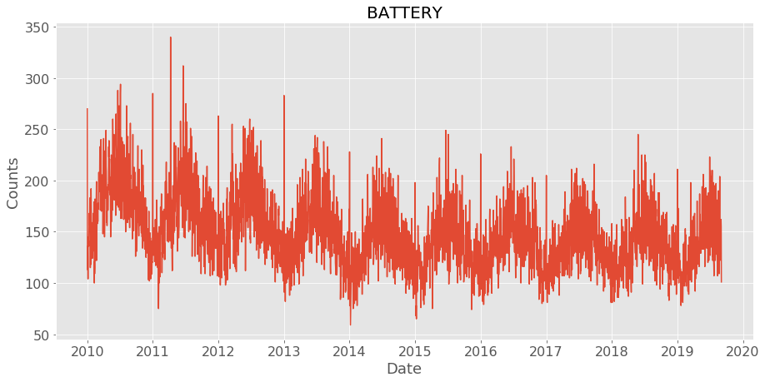
How models were chosen?
Data is fluctuating around a constant mean and almost all variation is within a constant band. Data comes from a stationary process.

Slide 22
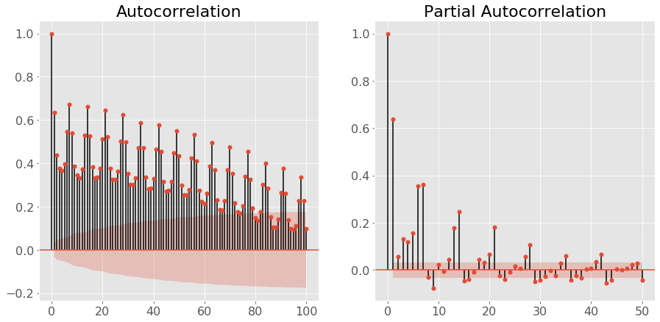
How models were chosen?
To decide model parameters, We need to look at ACF and PACF plots.
1. CASE1 - Gradual decrease in ACF and Definite cut off in PACF plot. That suggests AR(Auto Regressive) terms. To decide how many AR(Auto Regressive) terms we need to look at PACF plot and see how many bars are significantly out of confindence interval(red zone).
2. CASE2 - Gradual decrease in PACF and Definite cut off in ACF plot. That suggests MA(Moving Average) terms. To decide how many MA(Moving Average) terms we need to look at ACF plot and see how many bars are significantly out of confindence interval(red zone).
3. CASE3 - Definite cut off in both ACF and PACF plots. That suggests both AR(Auto Regressive) and MA(Moving Average) terms. To decide how many AR(Auto Regressive) terms we need to look at PACF plot and to decide how many MA(Moving Average) terms we need to look at ACF plot and see how many bars are significantly out of confindence interval(red zone).

Slide 23
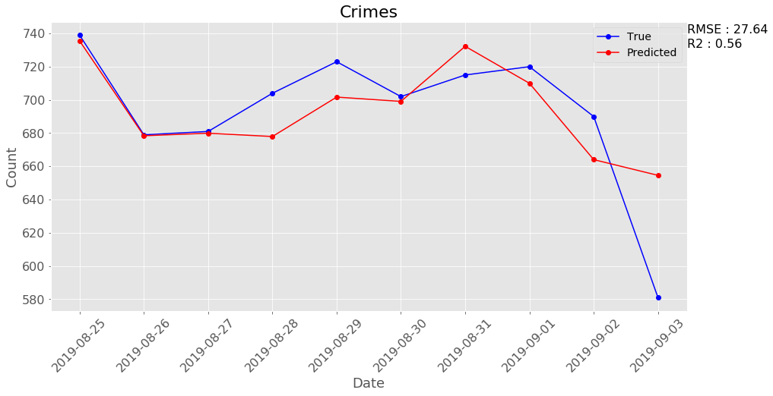
Total Crimes
Model - ARIMA(15, 1, 0)(0, 1, 0, 7) --> SARIMA - R2 = 56% - RMSE = 27.64

Slide 24
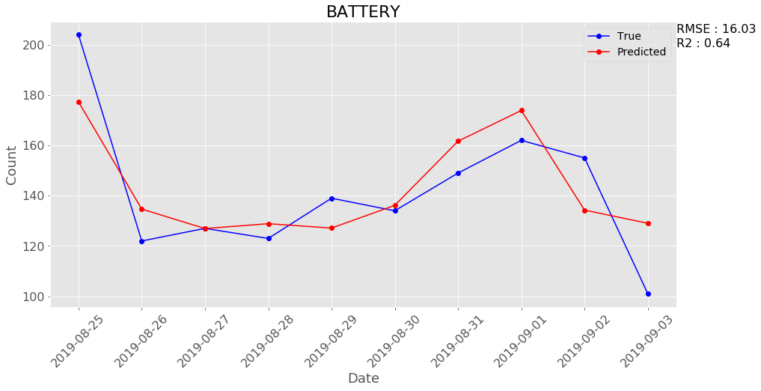
BATTERY
Model - ARIMA(15, 1, 0)(0, 1, 1, 7) --> SARIMA - R2 = 64% - RMSE = 16.03

Slide 25
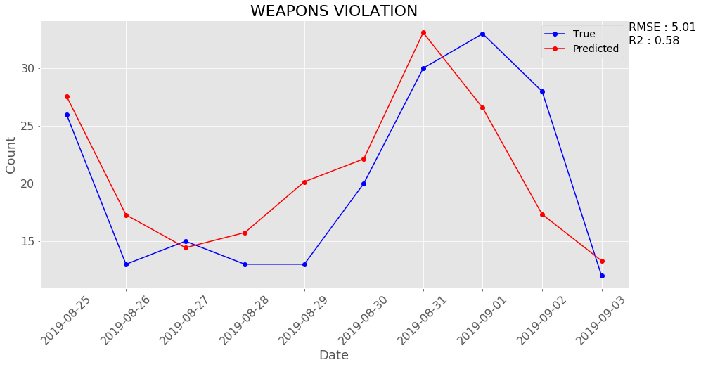
WEAPONS VIOLATION
Model - ARIMA(15, 0, 0)(0, 1, 0, 7) --> SARIMA - R2 = 58% - RMSE = 5.01

Slide 26
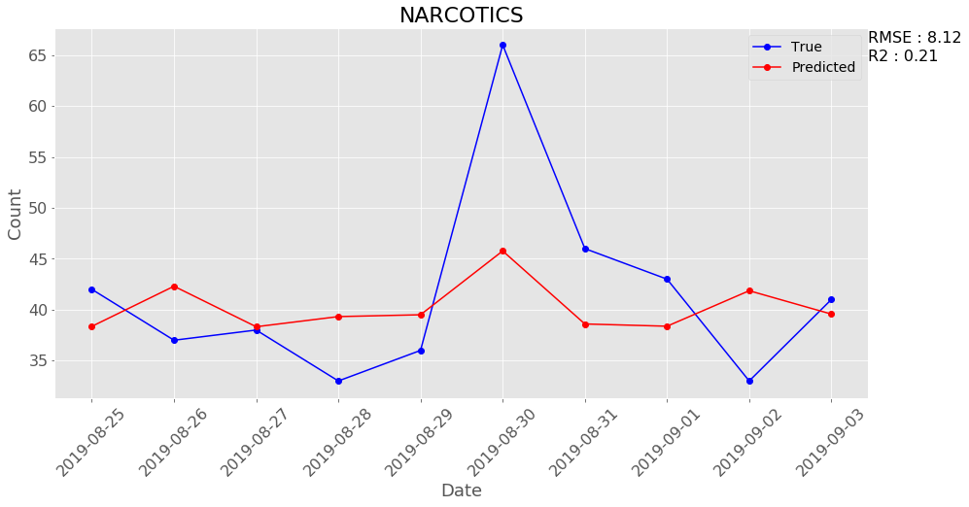
NARCOTICS
Model - ARIMA(6, 1, 0)(5, 1, 0, 7) --> SARIMA - R2 = 21% - RMSE = 8.12

Slide 27
Analysis
Over the period of last ten years, the crimes have deceased significantly
The crimes occur in large numbers in the month of July & August
The theft & Battery type crimes have occurred the most & the Robbery type the least
The crimes have occurred the most in Streets & Residential areas & the least in Restaurants
Only a quarter of criminals are arrested
Over a last decade, the number of criminals arrested have decreased
There is a significant decrease in the number of domestic crimes
Overall the rate of crimes and arrests have declined

Slide 28
Conclusion
In a nutshell, in this analysis, we examined a sample of 2.88 million crimes in the City of Chicago over the last decade and put forth a proposal to the Chicago Police Department on the frequency of impending crimes. This data analytics project gave us a scientific view about the security status and crime rate of the Chicago city. Initially, we found out that the most frequently occurring crimes were theft, battery, criminal damage and narcotics which is 65.7% of all the crimes reported. Street, sidewalks, residence, an apartment are the targeted regions of crime.
In our modelling, we started with binary classification to determine whether the committed crime resulted in an arrest or not and the best model was able to predict the arrest flag with 84% accuracy. Next, we carried out multiclass classification to predict the District in which the crime occurred, and the best model was able to predict the district with almost 100% accuracy.
ARIMA and SARIMA model did mediocre job(R2 around 60%) on variables like BATTERY, TOTAL CRIMES, WEAPONS VIOLATION, NARCOTICS. ARIMA and SARIMA performed very poor on other variables that suggest that we need to have better understanding of these models to create complex models to deal with other variables.

